Slide 1
6.867 Final Project
Eric Qian, Aaditya Singh, Albert Yue

Slide 2
Overview
Build a VAE to generate art
Use CNN to find relevant latent features
Generate art by category of art movement

Slide 3
Current Progress
VAE
Have an architecture that generates images
Considering normalizing data – debugging the code for this
CNN:
Transfer learning from resnet
~50% top-1 accuracy on a small set of images

Slide 4
VAE Architecture
5 Layers in encoder and decoder
32 -> 64 -> 128 -> 256 -> 512
All have filter size 3, stride 2

Slide 5

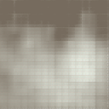
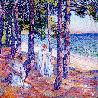

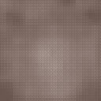
Results
Questions:
Why are there no actual colors? Is this because of MSE?
Is 20 or so epochs enough?
How exactly can we get this VAE to work?
5 layers, hidden layer size: 1000,
Latent vector size: 100
4 layers, hidden layer size: 2000,
Latent vector size: 100
5 layers, hidden layer size: 2000,
Latent vector size: 200
4 layers, hidden layer size: 2000,
Latent vector size: 200

